Slide 1
Have Your Pi and Eat It Too: .NET Core on Raspberry Pi
Cam Soper
Microsoft

Slide 2
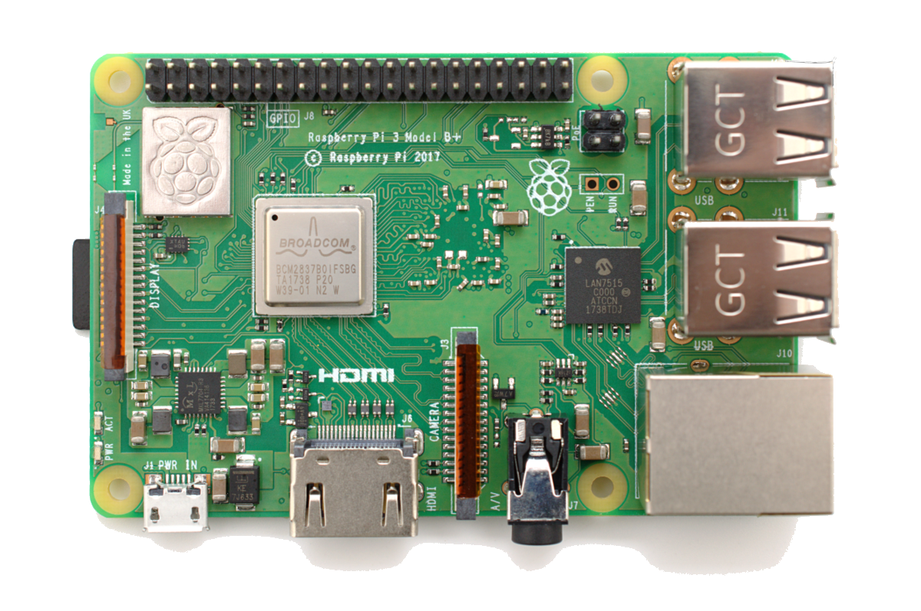
What we’ll cover
The basics
Development
Deployment
Debugging
GPIO
Control an LED
Control a reversible motor
Cloud integrations
Alert when a door is open/closed
Control your device with Cortana

Slide 3
The Basics The berry beginning…

Slide 4
Demo: Building, Deployment, and Debugging

Slide 5
GPIO Putting the “things” in IoT

Slide 6
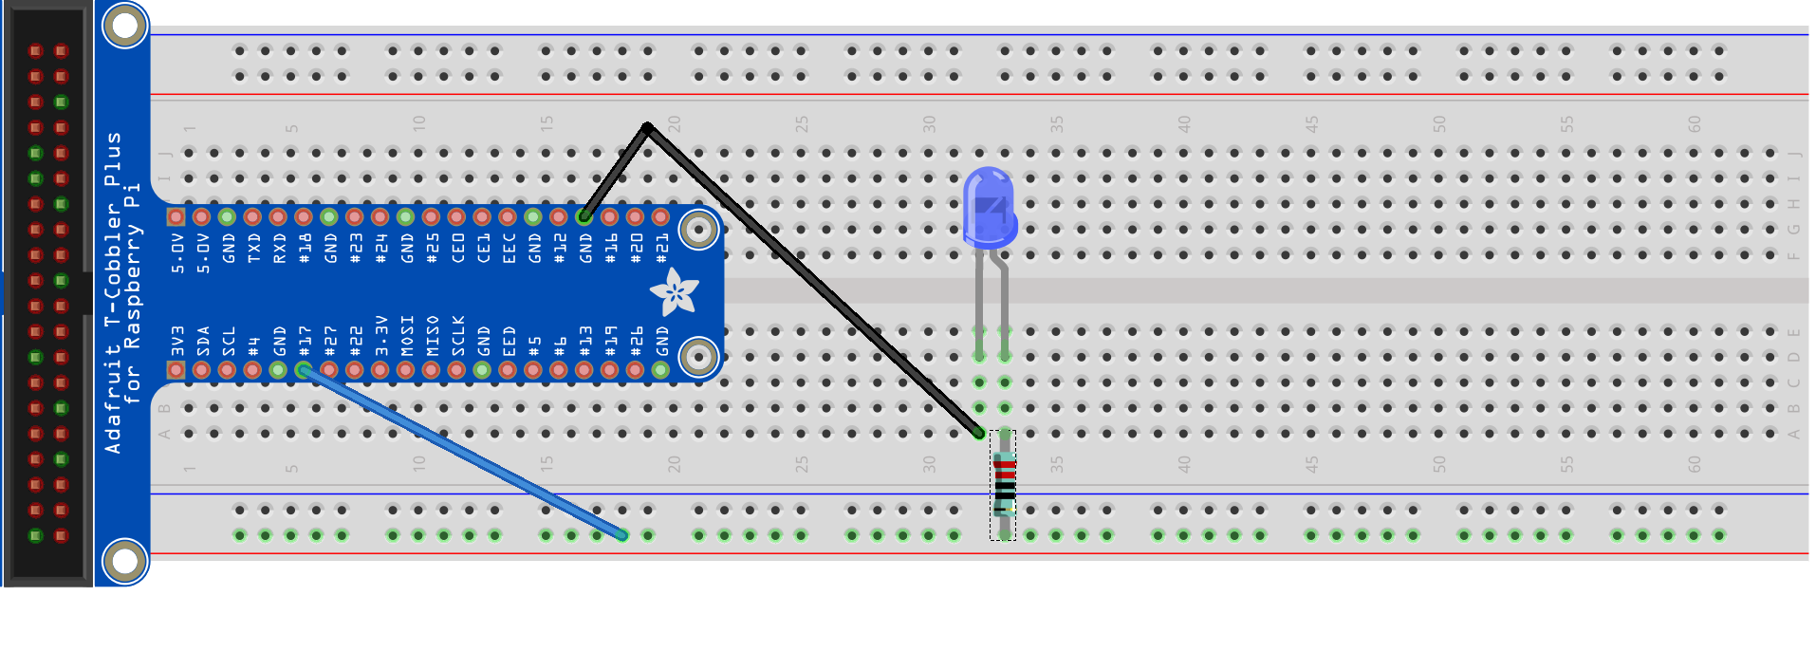
Hello world (LED)
Ground
GPIO 17

Slide 7
Demo: Hello World (LED)

Slide 8
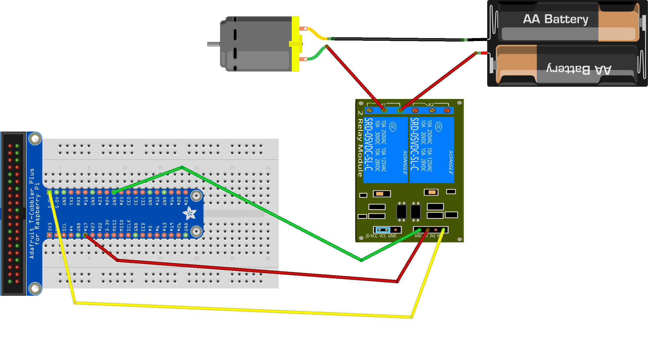
Hello World (Motor)
Ground
GPIO 17
5V

Slide 9
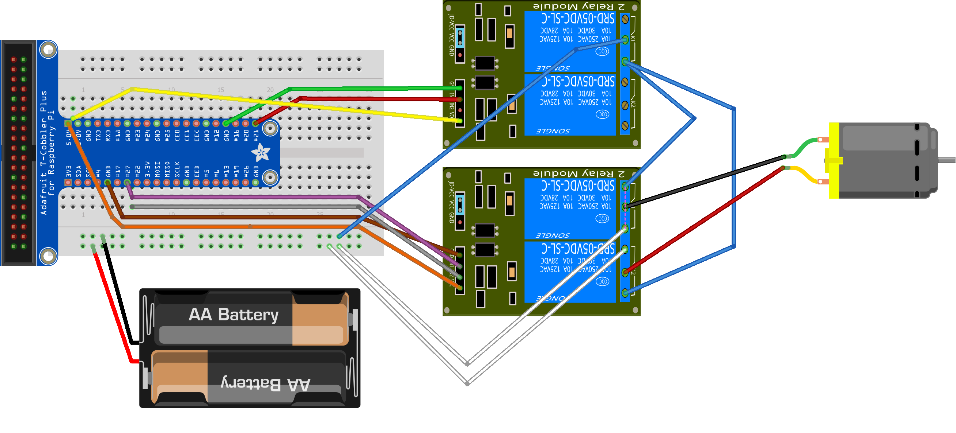












Reversible motor
GPIO 21
Positive
Negative
Negative
Positive
GPIO 27

Slide 10
Demo: Motors

Slide 11
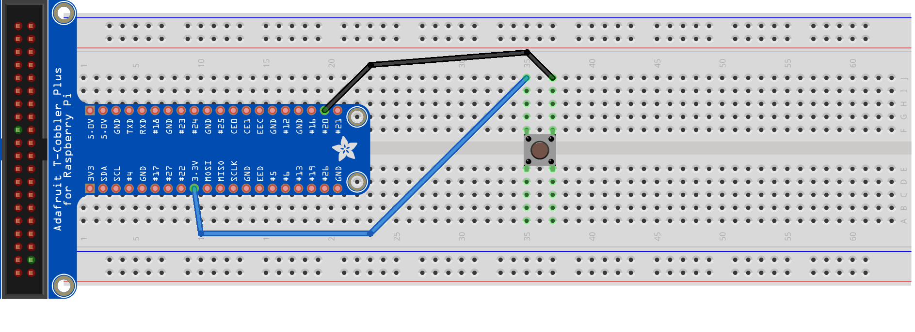
Push Button
GPIO 20
3.3 V

Slide 12
Demo: Push Button

Slide 13
Cloud Integrations What’s IoT without the Internet?

Slide 14
Demo: Door Alerts

Slide 15

Build status indicator light

Slide 16
Demo: Build Status Indicator

Slide 17


Cortana integration
Hey, Cortana…

Slide 18
Cortana integration
Hey, Cortana…

Slide 19
Demo: Cortana Integration

Slide 20
What’s next?

Slide 21
What to look at next
https://github.com/camsoper/have-your-pi
Notes
Demos
Slides
Schematics
System.Devices.Gpio
Prerelease, targeted for .NET Core 3.0
API surface is likely to change
Designed for several IoT platforms (Raspberry Pi included)
Supports all the functionality demonstrated here, but adds support for:
PWM
SPI
I2C
The team is looking for contributors! Visit: http://github.com/dotnet/corefxlab

Slide 22
Questions?

Slide 23


Thank you! @CamSoper CamSoper

